Slide 1
Exercise 1
Before you do this exercise, kindly check if you have already imported the three pictures (Button moon, Hector and Sean) in your VS Blend.

Slide 2
Basic Windows Exercise
WPF - Visual C# | Basic windows exercise | Simple window using images, borders and a stack panel

Slide 3
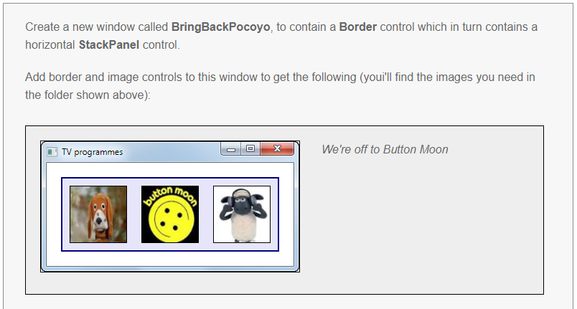

Slide 4
